Slide 1
Sales Analysis Report (2011–2015)
Presented By: Ayush Rajput

Slide 2
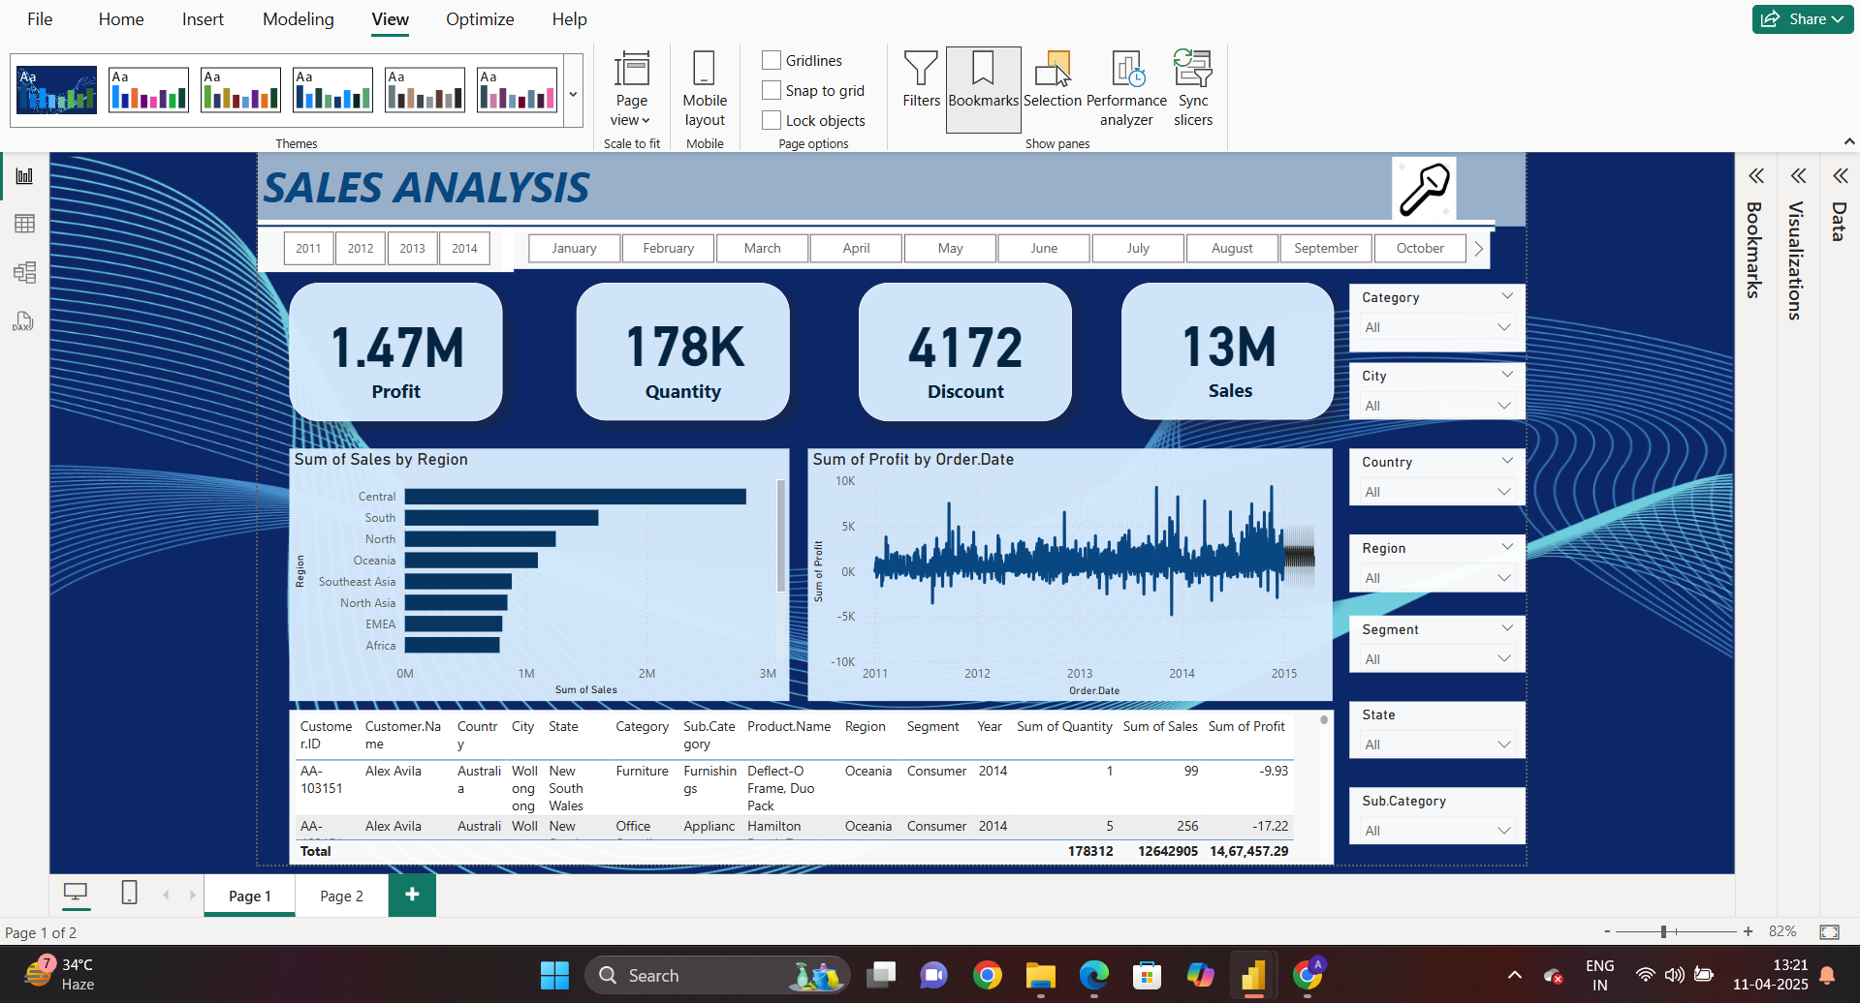

Slide 3
Overall Performance (2011–2015)
Total Sales: ₹13 Million
Total Profit: ₹1.47 Million
Total Quantity Sold: 178K units
Total Discounts Given: 4,172 instances

Slide 4
Sales by Region
The Central region is the top performer in terms of sales.
South and North regions also contribute significantly.
Africa and EMEA show the lowest sales figures, indicating potential for market development
or re-evaluation.

Slide 5
Profit Trends Over Time
Profit shows frequent fluctuations between 2011 and 2015.
Several spikes and dips suggest promotions, discount strategies, or market volatility.
Some periods reflect negative profits, possibly due to high discounts or low-margin sales.

Slide 6
Business Recommendations
Enhance marketing in low-performing regions.
Optimize discount strategy to prevent profit loss.
Invest more in high-performing products and regions.
Regularly monitor sales trends to adapt strategies.

